Slide 1

PROJECT 6
MY DREAM

Slide 3

FC BARCELONA

Slide 4
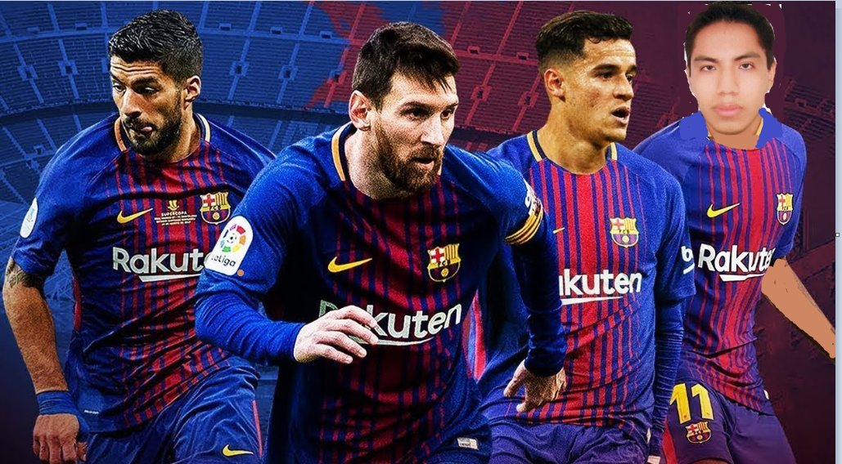
Partners

Slide 5

Barcelona vs Real Madrid

Slide 6
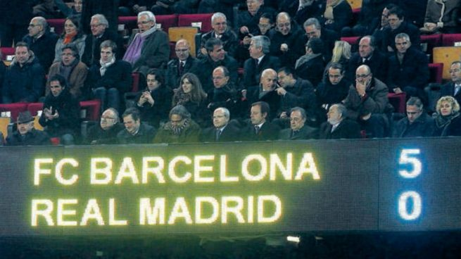
match result

Slide 7
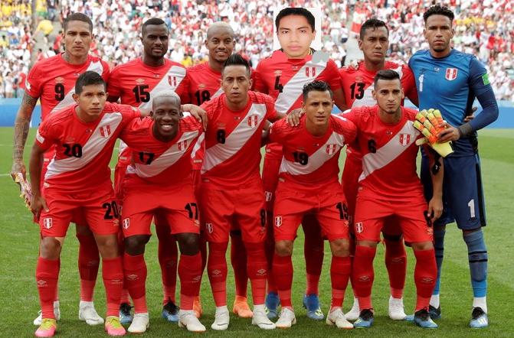
Perú

Slide 8


Slide 9
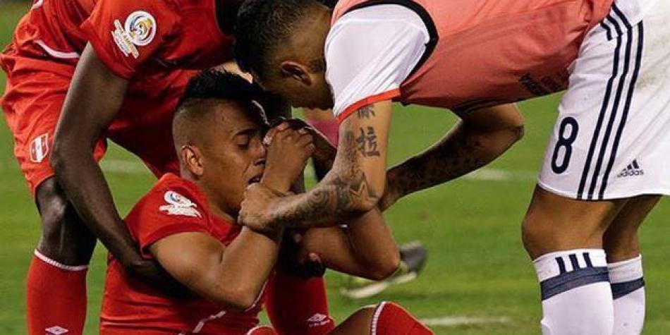

Slide 10
